Slide 1
The Programmer's Mental Model of a Motor
YOUR CODE
In robotics applications, bi-directional control of motor speed is necessary.
This requires a Pulse width modulation (PWM) amplifier to be bipolar, allowing for both forward and backward rotations.
DC motors and PWM amplifiers, are the two most important components involved in a robot power train.
Encoder
PWM Amplifier (H-Bridge)
Forward command
Reverse command
Brake command
DC MOTOR
Input: Voltage (via PWM)
Output: Torque + Speed
ENCODER
Output: Position pulses (A, B phases)
YOUR CODE (AGAIN)
Read encoder, compute next command

Slide 2
Path Planning in Robotics
From Geometric Paths to Time‑Optimal Trajectories

Slide 3
Path Planning in Robotics
Path planning is the process of determining a collision-free route from a start position to a goal position.
Key Idea
Find where to move (geometry)
Not necessarily how fast (that’s trajectory planning)
Path - geometric route (no time)
Trajectory - path + timing
Important - planning vs execution

Slide 4

Path vs Trajectory
Path - geometric route (no time)
Trajectory - path + timing. The position of the robot as a function of time q(t) where q is robot position and t is time
The robot’s position is defined for every moment in time from $t_{0}$to $t_{f}$(time zero to time final)
Term | Definition | Parameters
Path | Geometric locus of points (no time) | q(s), s∈[0,1]
Trajectory | Path + time + velocity + acceleration | q(t), velocity, acceleration

Slide 5
Types of Planning
Type | Description
Global Planning | Uses full map knowledge
Local Planning | Reacts to environment in real-time
Static Planning | Environment does not change
Dynamic Planning | Environment changes

Slide 6
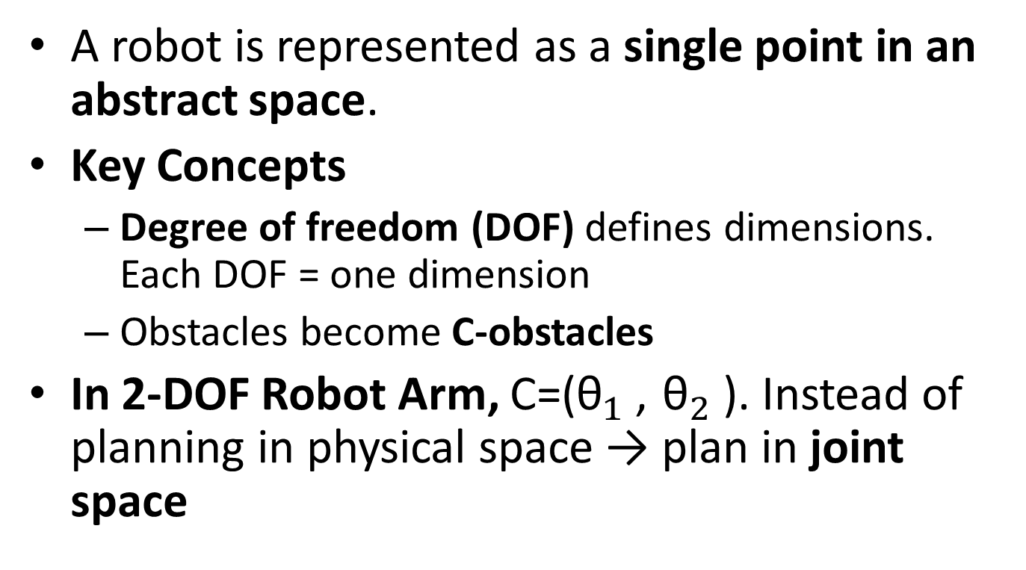
Configuration Space (C-Space)
A robot is represented as a single point in an abstract space.
Key Concepts
Degree of freedom (DOF) defines dimensions. Each DOF = one dimension
Obstacles become C-obstacles
In 2-DOF Robot Arm, C=(${\text{θ}}_{1}$, ${\text{θ}}_{2}$). Instead of planning in physical space → plan in joint space

Slide 7
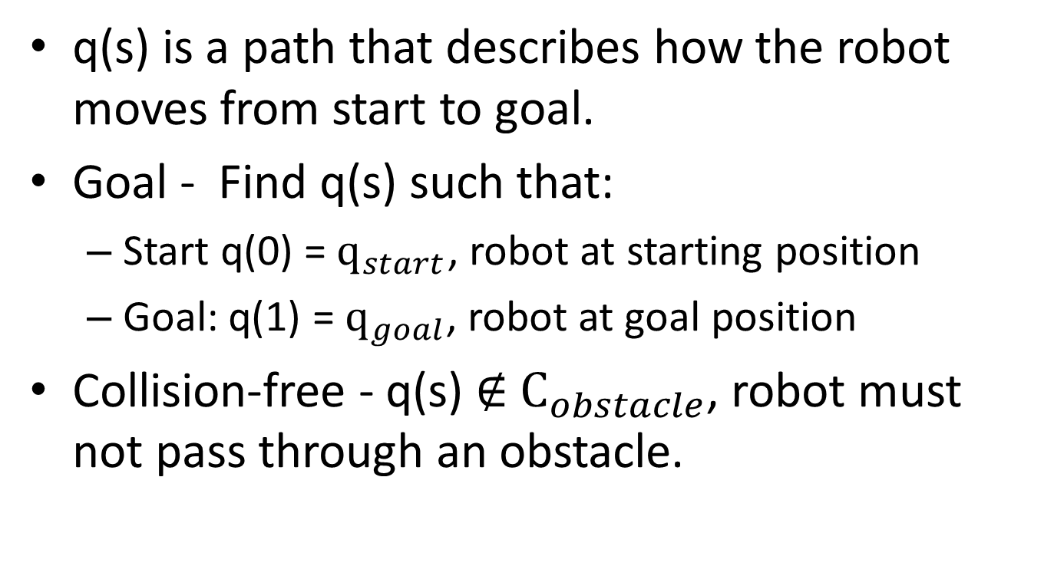
Problem (Goal) Formulation
q(s) is a path that describes how the robot moves from start to goal.
Goal - Find q(s) such that:
Start q(0) = ${\text{q}}_{start}$, robot at starting position
Goal: q(1) = ${\text{q}}_{goal}$, robot at goal position
Collision-free - q(s) ∉ ${\text{C}}_{obstacle}$, robot must not pass through an obstacle.

Slide 8
Graph-Based Planning
Convert space into a graph - Nodes = positions and Edges = valid paths
Visibility Graph
Connect all vertices of obstacles; optimal for polygonal obstacles. Produces shortest path. Not safe since the path is too close to obstacles
Voronoi Diagram
maximizes distance from obstacles. Safe but not shortest
Cell Decomposition
divide space into regions (simple cells), search adjacency graph
Search: Dijkstra – weighted graph, guarantees shortest path and A* – heuristic‑guided, faster for many problems

Slide 9
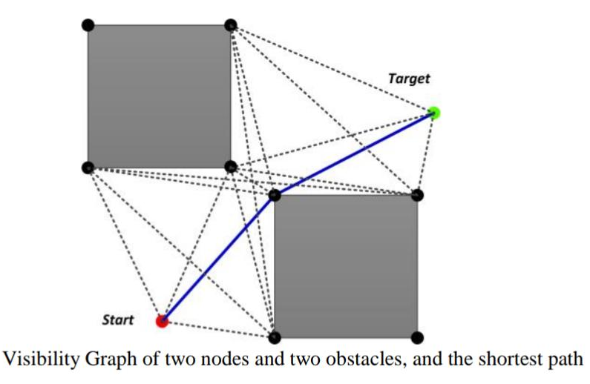

Graph based - Visibility Graph
If you can draw a straight line without hitting an obstacle, connect the points.
Given – start (1,1), goal(9,9), obstacle vertices A(4,4), B (6,4) C(6,6) and D(4,6)
Exercise. Plot the points in a graph and identify the paths between start and goal.
Identify the shortest path
Use Eucladian distance

Slide 10
Why Visibility Graph Gives Shortest Path
It connects all straight-line possibilities
The shortest path lies along, straight lines and obstacle edges
Visibility is not save because, visibility graph paths
pass very close to obstacles
sometimes touch corners
Risky in real robots due to:
sensor noise
control errors

Slide 11
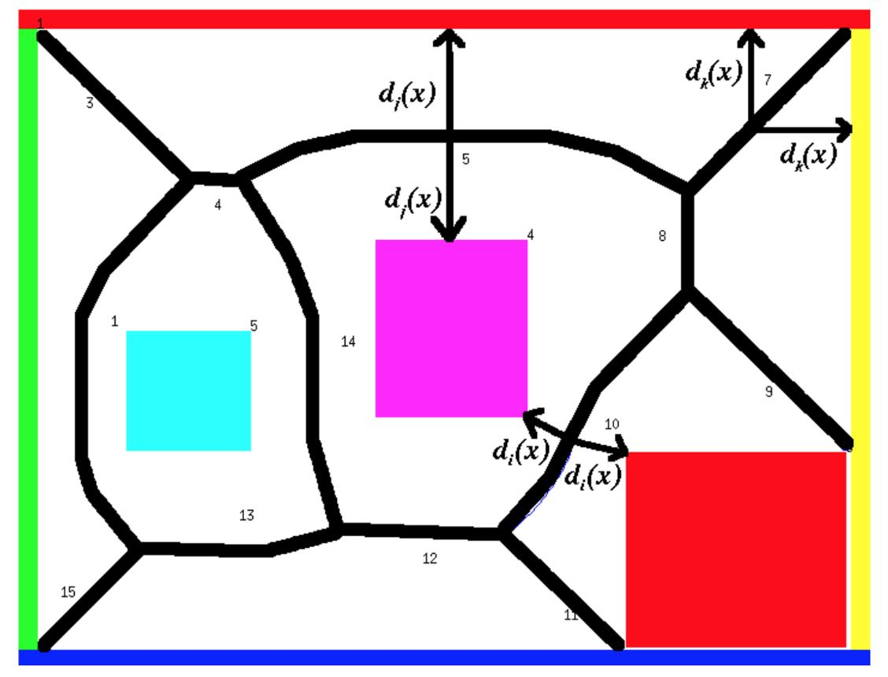
Graph based - Voronoi Diagram
A Voronoi Diagram divides space such that Every point on a Voronoi edge is equidistant from the nearest obstacles
Move along paths that are as far away from obstacles as possible.
The lines (edges) run between obstacles
These lines form a safe roadmap
Given that Start: S=(1,1), Goal: G=(9,9), Two obstacles: Obstacle 1 at (4,5), Obstacle 2 at (6,5).
Calculate the midpoint between the obstacles x = (4+6)/2 = 5
from Howie Choset

Slide 12
Graph based - Voronoi Diagram
Given that Start S=(1,1), goal G=(9,9), two obstacles, Obstacle 1 at (4,5), Obstacle 2 at (6,5).
Calculate the midpoint between the obstacles x = (4+6)/2 = 5, which is the Voronoi edge.
Voronoi condition is distance to obstacle 1 and obstacle two are the same.
Constructing the Voronoi Path
Step 1. Build Voronoi edges
The vertical line x=5 forms a safe corridor
Step 2. Connect Start to Voronoi
From S=(1,1)
Move toward the nearest Voronoi edge
Connect to point (5,3) between start S and mid point x=5
Step 3. Follow Voronoi edge
Move along x=5
Step 4. Connect to Goal
Leave Voronoi at (5,7)
Move to G=(9,9)G
The final path is. S→(5,3)→(5,7)→G

Slide 13
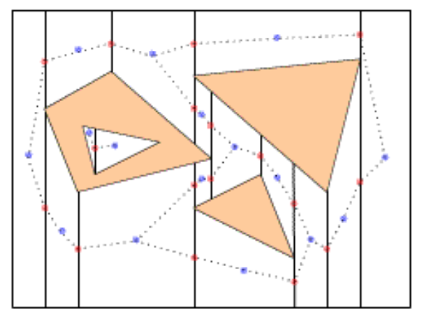
Graph based - Voronoi Algorithm
Add start and goal to the graph
Connect them to nearest Voronoi nodes
Use shortest path search (A*)
from Philippe Cheng, MIT, 2001)
Intuition Pick a safe point on the Voronoi line that the robot can reach without hitting obstacles. (5,3) is a convenient, safe connection point chosen on the Voronoi edge, not a fixed formula output.

Slide 14
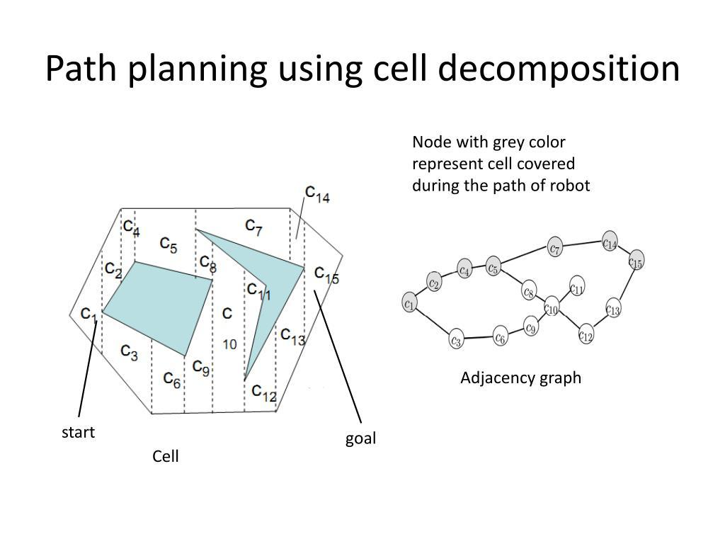
Graph based - Cell Decomposition
Divide the free space into simple regions (cells), then move from one cell to another.
Algorithm
Split space into non-overlapping regions (cells)
Identify which cells are free (no obstacles)
Build a graph of connected cells
Find a path through the cells, Use algorithms like: A*, BFS, Dijkstra.
Convert Cell Path to Real Path. Move from center to center or boundary to boundary

Slide 15
Dijkstra’s Algorithm
Finds the shortest path from a source node to all other nodes in a weighted graph (weights are non-negative).
Works only with non-negative edge weights.
Guarantees the shortest path.
Uses a greedy approach, always selects the node with the smallest known distance that hasn’t been visited yet.
Maintains a distance table for the shortest known distance from the source to each node.

Slide 16
Dijkstra’s Algorithm
Steps
Assign every node a tentative distance value: 0 for the source, ∞ for all others.
Set the source node as current.
For the current node, consider all unvisited neighbors. Calculate tentative distances through the current node.
If the calculated distance is less than the current recorded distance, update it.
Mark the current node as visited (we now know the shortest distance to it).
If there are unvisited nodes left, select the unvisited node with the smallest tentative distance as the new current node.
Repeat steps 3–6 until all nodes are visited.

Slide 17
Dijkstra’s Algorithm Pseudocode
Algorithm Dijkstra(Graph, source)
Input: Graph with nodes and weighted edges, source node
Output: Shortest distance from source to all other nodes
1. Create a set of unvisited nodes, Unvisited = all nodes in Graph
2. For each node n in Graph
distance[n] = ∞ // tentative distance
previous[n] = undefined // to store the path
3. distance[source] = 0 // distance to itself is 0
4. While Unvisited is not empty
a. current = node in Unvisited with smallest distance
b. For each neighbor n of current that is in Unvisited:
i. alt = distance[current] + weight(current, n)
ii. If alt < distance[n]
distance[n] = alt
previous[n] = current
c. Remove current from Unvisited
5. Return
distance[], previous[]

Slide 18
A* Algorithm
A* (A-star) is a search algorithm used to find the shortest path from a start point to a goal while avoiding obstacles.
Always move in the direction that looks cheapest AND closest to the goal.
f(n) = g(n) + h(n), where
g(n) is cost from start → current node
h(n) is estimated cost from current → goal (heuristic - shortcut that is usually good enough)
Total estimated cost
A* chooses the node with the smallest f(n)
Heuristic must be admissible
Efficient shortest path search

Slide 19
How A* Works (Step-by-Step)
Step 1. Initialize
Put start node in OPEN list
CLOSED list = empty
Step 2. Repeat
Pick node with lowest f(n)
Move it to CLOSED list
Expand its neighbors
Update costs
Add neighbors to OPEN list
Step 3. Stop
When the goal node is reached

Slide 20
Example, Grid-Based Robot
S = Start (0,0), G = Goal (4,4), X = Obstacle
S . . . . . X X . . . . . X . . X . . . . . . . G
h(n) = ∣xgoal​−x∣ + ∣ygoal ​− y∣, called Manhattan distance
Initially, g=0,
h(n)= (4-0)+(4-0)=8
f(n) = 0 + 8 = 8
Expand neighbor from (0,0) to (1,0) and (0,1)
Node (1,0), g=1
h(n)= (4-1)+(4-0)=7
f(n) = 1 + 7 = 8
Node (1,0), g=1 (moved one step from 0,0 to 0,1
h(n)= (4-0)+(4-1)=7
f(n) = 1 + 7 = 8

Slide 21
Why A* is Powerful
It combines:
Dijkstra → shortest path
Greedy search → goal-directed
Heuristic Importance
Good heuristic- speeds up search and gives optimal path
Bad heuristic- slows down and may give wrong path
Condition - h(n)≤true cost, called admissible heuristic

Slide 22
Programming Structure
open_list = [start]
closed_list = []
while open_list:
current = node_with_lowest_f()
if current == goal:
return path
move current to closed_list
for neighbor in neighbors:
compute g, h, f
update parent
Robotics Applications
A* is used in:
mobile robot navigation
autonomous vehicles
game AI
warehouse robots
Intuition: A* finds the shortest path by balancing cost so far and estimated distance to the goal.

Slide 23
A* Algorithm
Advantages
Disadvantages
Finds optimal path
Efficient with good heuristic
Widely used
Can be slow in large spaces
Needs good heuristic
High memory usage

Slide 24
BFS (Breadth-First Search) in Path Planning
Purpose
BFS is used to find the shortest path in an unweighted graph or grid.
Guarantees the minimum number of steps (not necessarily the shortest in distance if edges have weights).
Explores nodes level by level (all nodes at distance 1, then distance 2, etc.).
Key points for robotics
Grid-based maps are common (cells = nodes).
Obstacles are blocked cells.
BFS finds the safest and shortest route in terms of steps.
Often used in discrete environments.

Slide 25
Algorithm Steps
Initialize a queue and add the start node.
Mark the start node as visited.
While the queue is not empty a. Remove the front node from the queue (current node). b. For each neighbor of the current node (up, down, left, right in a grid) - If the neighbor is walkable and not visited: - Mark it as visited. - Store its parent (to reconstruct path). - Add it to the queue.
If the goal node is reached, reconstruct the path using the parents.

Slide 26
Sampling-Based Path Planning
Instead of explicitly modeling all free space, we, sampling based path planning
Randomly sample configurations
Keep only collision-free samples
Connect them to form a graph or tree
Search for a path
Don’t map everything, just explore enough of the space to find a path
There are two Sampling-Based Methods
Rapidly-Exploring Random Tree (RRT)
Probabilistic Roadmap (PRM)

Slide 27
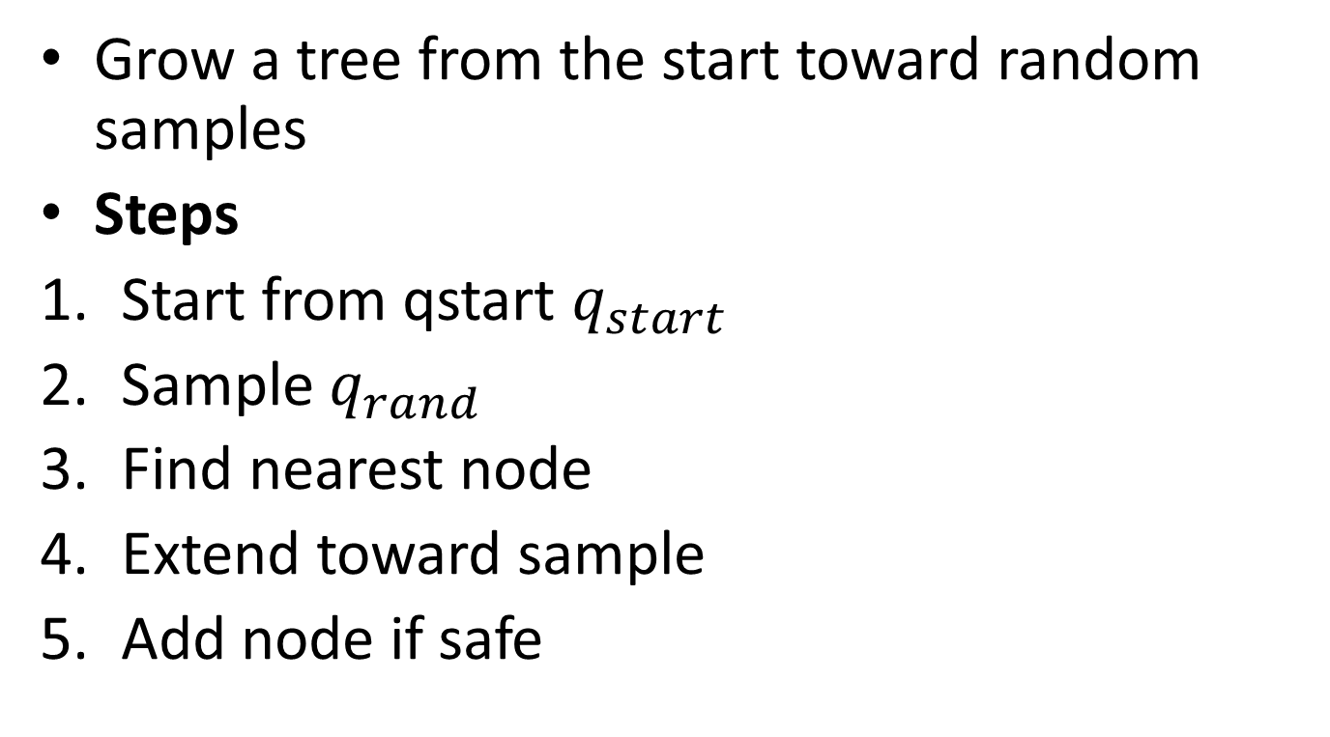
Rapidly-Exploring Random Trees (RRT)
Grow a tree from the start toward random samples
Steps
Start from qstart $q_{start}$
Sample $q_{rand}$
Find nearest node
Extend toward sample
Add node if safe

Slide 28
Rapidly-Exploring Random Trees (RRT)
Rapidly-Exploring Random Trees (RRT) are fundamental for motion planning in robotics, especially for high-dimensional systems like robot arms
RRT is a sampling-based path planning algorithm that builds a tree by:
Randomly sampling points in space
Connecting them to the nearest existing node
Growing toward unexplored regions

Slide 29
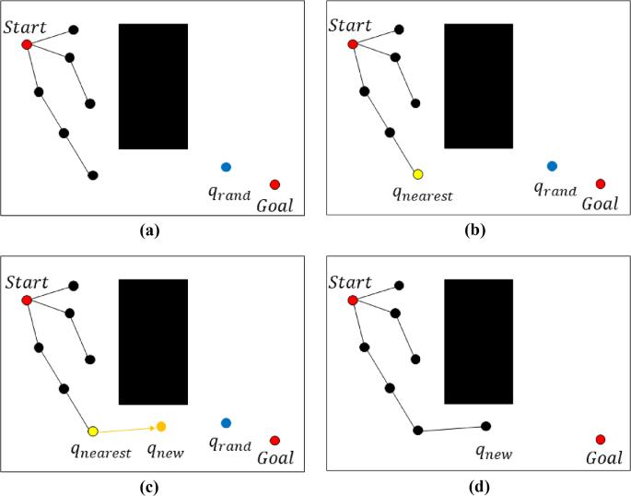
Rapidly-Exploring Random Trees RRT
Grow a tree from the start by randomly exploring the space until you reach the goal.
RRT algorithm is a single-query method that quickly generates a route by finding the destination while expanding the roadmap from the starting point.

Slide 30
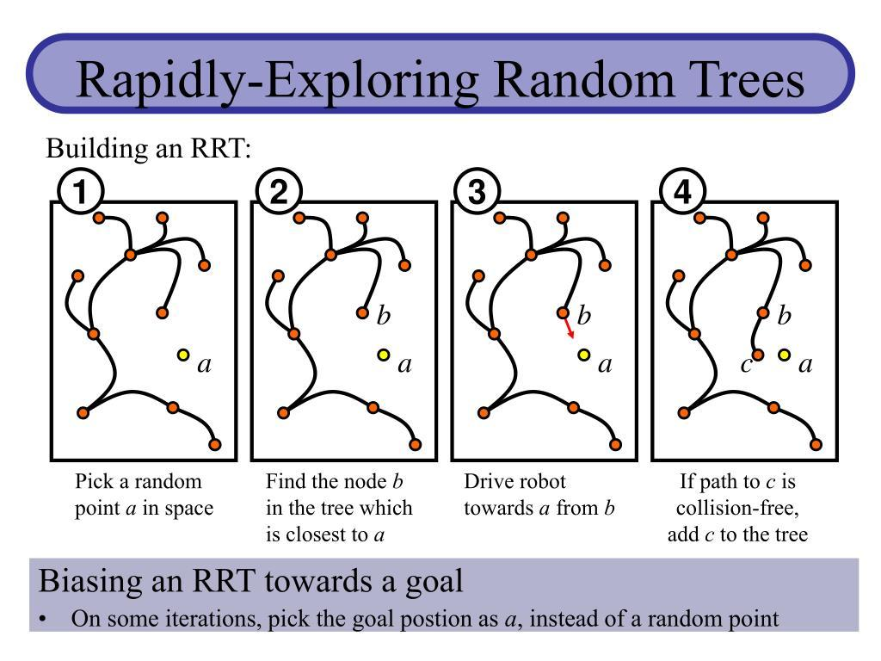

Slide 31
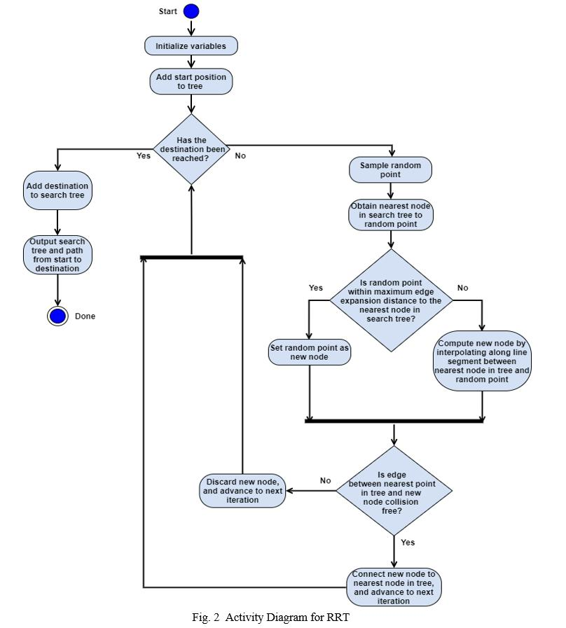

Slide 32
Sampling-Based Planning (RRT)
Rapidly‑exploring Random Tree (RRT)
Grow a tree by randomly sampling configurations and extending toward them.
Properties
Probabilistically complete
Random sampling + tree expansion
Variants: RRT*, Informed RRT for optimality
Good for high-dimensional spaces

Slide 33
RRT Algorithm
Every node is connected to another node called a “parent”, and the start point becomes the root.
A sample node (𝑞𝑟𝑎𝑛𝑑) is generated, and the closest node (𝑞𝑛𝑒𝑎𝑟) from 𝑞𝑟𝑎𝑛𝑑 is found in the tree (a).
A node separated by distance (𝑟) on a straight line connected from 𝑞𝑛𝑒𝑎𝑟 to 𝑞𝑟𝑎𝑛𝑑 is generated as a new node (𝑞𝑛𝑒𝑤) (b).
𝑞𝑛𝑒𝑤 is then added to the tree if a straight line from 𝑞𝑛𝑒𝑎𝑟 to 𝑞𝑛𝑒𝑤 does not collide with an obstacle.
This process is repeated (c). If the straight line from 𝑞𝑛𝑒𝑎𝑟 to q_{new} collides with an obstacle in the tree-expanding step, the existing node 𝑞𝑟𝑎𝑛𝑑 is discarded (d), and a new node 𝑞𝑟𝑎𝑛𝑑 is generated.
The tree generation process is then repeated (e).

Slide 34
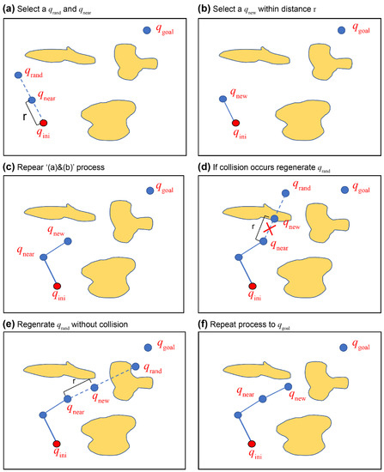
RRT Algorithm

Slide 35
RRT Algorithm
a) Select a 𝑞𝑟𝑎𝑛𝑑 and 𝑞𝑛𝑒𝑎𝑟,
(b) select a 𝑞𝑛𝑒𝑎𝑟 within distance 𝑟,
(c) repeat ‘(a) and (b)’ process, (d) if collision occurs regenerate 𝑞𝑟𝑎𝑛𝑑,
(e) regenerate 𝑞𝑟𝑎𝑛𝑑 without collision, and
(f) repeat process to 𝑞𝑔𝑜𝑎𝑙.
Jang, D.-u., & Kim, J.-s. (2022). Development of Ship Route-Planning Algorithm Based on Rapidly-Exploring Random Tree (RRT*) Using Designated Space. Journal of Marine Science and Engineering, 10(12), 1800. https://doi.org/10.3390/jmse10121800

Slide 36
Rapidly‑exploring Random Tree (RRT) Algorithm
RRT(start, goal, max_iter):
tree = {start}
for i in 1..max_iter:
q_rand = sample_configuration()
q_near = nearest_neighbor(tree, q_rand)
q_new = steer(q_near, q_rand, step_size)
if collision_free(q_near, q_new):
tree.add(q_new)
if distance(q_new, goal) < threshold:
return path
reurn failure

Slide 37
The Probabilistic Road Map (PRM)
Build a network (roadmap) of random points, then search through it
Steps
Sample random points in free space
Keep collision-free points
Connect nearby points
Build a graph
Use A* or Dijkstra to find path

Slide 38
The Probabilistic Road Map (PRM)
The PRM is a network graph of the possible routes in each map based on free and occupied spaces.
First, the nodes are randomly generated in a space with obstacles (a).
Whether a node is in free space is checked using the multiple-query method, after which it is connected to the closest node at a certain distance (b)
Whether the edge that interconnects the nodes crosses an obstacle can then be determined (c)
The roadmap is generated by repeating this
Process until all samples are passed and the optimal route is found (d)

Slide 39
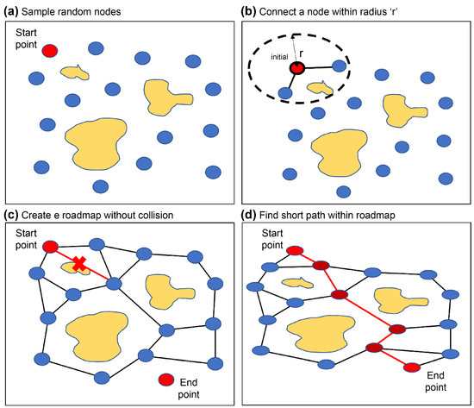
PRM algorithm

Slide 40
PRM
Two‑phase method
Construction phase
Randomly sample collision‑free configurations
Connect nearby samples with collision‑free local paths
Query phase
Connect start/goal to graph
Search for shortest path
Advantages
Precomputation for multiple queries
Works well in static environments
Trade‑off: Less efficient for single queries than RRT.

Slide 41
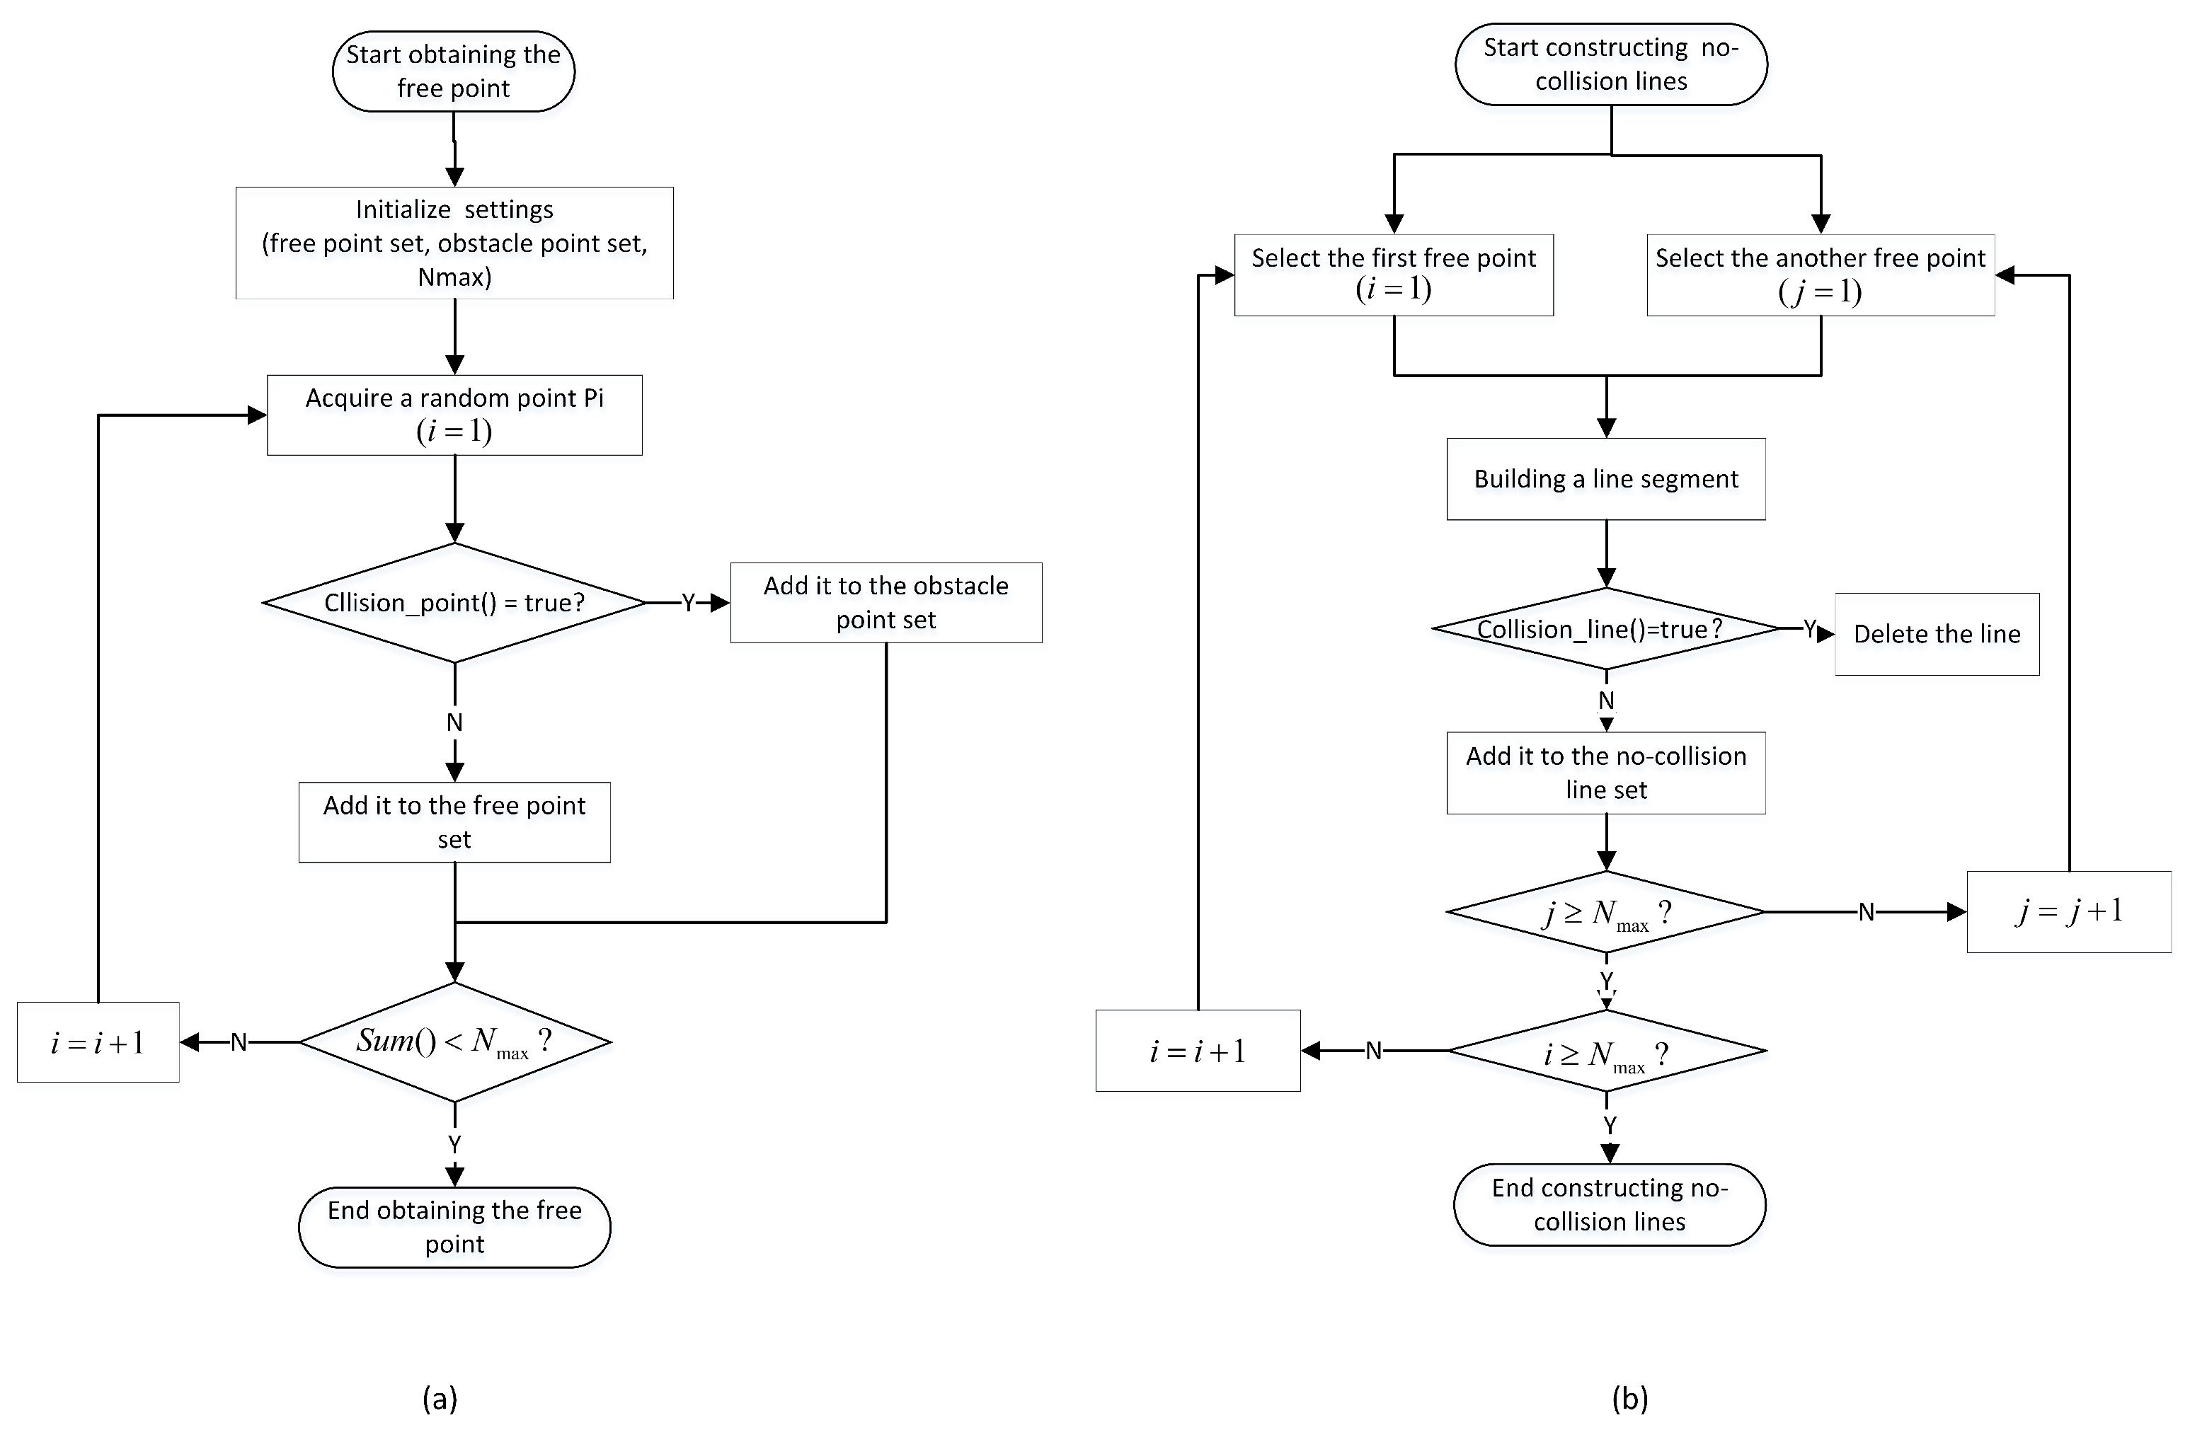
PRM
The learning process of typical PRM algorithm: (a) Obtaining free points; and (b) constructing collision-free line segments.

Slide 42
Probabilistic Roadmaps (PRM)
Advantages
Good for repeated queries
Efficient once roadmap is built
Disadvantages
Slow initial construction
Not ideal for single query

